Slide 1
File Organisation
- Shivali Chopra

Slide 2
File Organisation
File – A file is named collection of related information that is recorded on secondary storage such as magnetic disks, magnetic tables and optical disks.
What is File Organization? File Organization refers to the logical relationships among various records that constitute the file, particularly with respect to the means of identification and access to any specific record. In simple terms, Storing the files in certain order is called file Organization. File Structure refers to the format of the label and data blocks and of any logical control record.
Notes:
A database consist of a huge amount of data. The data is grouped within a table in RDBMS, and each table have related records. A user can see that the data is stored in form of tables, but in actual this huge amount of data is stored in physical memory in form of files.
The File is a collection of records. Using the primary key, we can access the records. The type and frequency of access can be
determined by the type of file organization which was used for a given set of records. o File organization is a logical relationship among various records.
This method defines how file records are mapped onto disk blocks. File organization is used to describe the way in which the records
are stored in terms of blocks, and the blocks are placed on the storage medium.---
o The first approach to map the database to the file is to use the several files and store only one fixed length record in any givenfile. An alternative approach is to structure our files so that we can contain multiple lengths for records.
o Files of fixed length records are easier to implement than the files of variable length records.

Slide 3
Types of File Organizations
Various methods have been introduced to Organize files. These particular methods have advantages and disadvantages on the basis of access or selection . Thus it is all upon the programmer to decide the best suited file Organization method according to his requirements. Some types of File Organizations are :
Sequential File Organization
Heap File Organization
Hash File Organization
Notes:
File organization contains various methods. These particular methods
have pros and cons on the basis of access or selection. In the file
organization, the programmer decides the best-suited file organization
method according to his requirement.

Slide 4
Sequential File Organization –
The easiest method for file Organization is Sequential method. In this method the file are stored one after another in a sequential manner. There are two ways to implement this method:
1. Pile File Method – This method is quite simple, in which we store the records in a sequence i.e one after other in the order in which they are inserted into the tables.
Insertion of new record –
Let the R1, R3 and so on upto R5 and R4 be four records in the sequence. Here, records are nothing but a row in any table. Suppose a new record R2 has to be inserted in the sequence, then it is simply placed at the end of the file.
2. Sorted File Method –In this method, As the name itself suggest whenever a new record has to be inserted, it is always inserted in a sorted (ascending or descending) manner. Sorting of records may be based on any primary key or any other key.

Slide 5
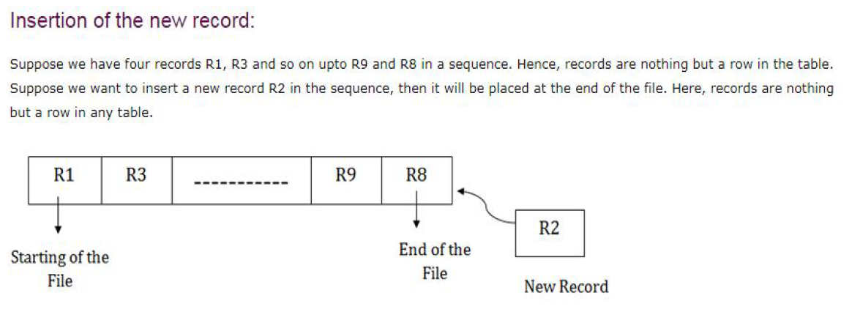
Notes:
Pile up method

Slide 6
Insertion of new record –
Let us assume that there is a preexisting sorted sequence of four records R1, R3, and so on upto R7 and R8. Suppose a new record R2 has to be inserted in the sequence, then it will be inserted at the end of the file and then it will sort the sequence .
Pros and Cons of Sequential File Organization –
Pros –
▪ Fast and efficient method for huge amount of data.
▪ Simple design.
▪ Files can be easily stored in magnetic tapes i.e cheaper storage mechanism.
Cons –
▪ Time wastage as we cannot jump on a particular record that is required, but we have to move in a sequential manner which takes our time.
▪ Sorted file method is inefficient as it takes time and space for sorting records.

Slide 7
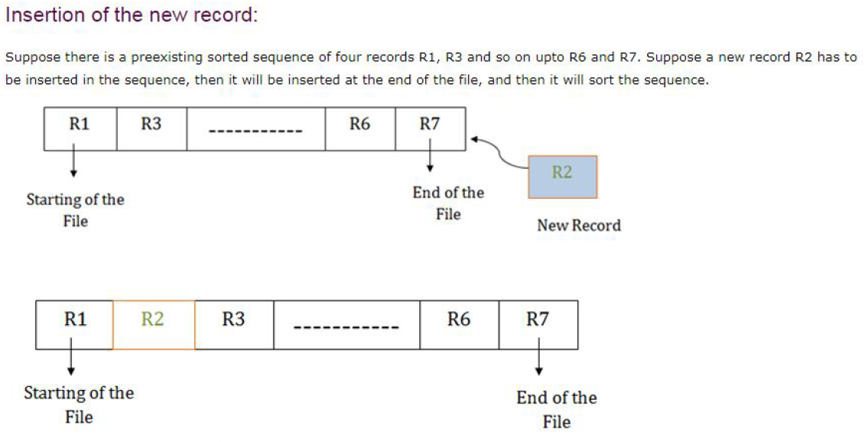
Notes:
Sorted file method

Slide 8
Heap File Organization
Heap File Organization works with data blocks. In this method records are inserted at the end of the file, into the data blocks. No Sorting or Ordering is required in this method. If a data block is full, the new record is stored in some other block, Here the other data block need not be the very next data block, but it can be any block in the memory. It is the responsibility of DBMS to store and manage the new records

Slide 9
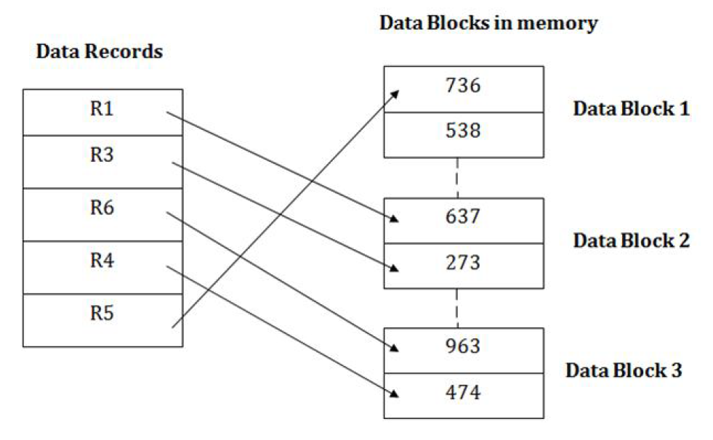

Slide 10
Insertion of new record –
Suppose we have four records in the heap R1, R5, R6, R4 and R3 and suppose a new record R2 has to be inserted in the heap then, since the last data block i.e data block 3 is full it will be inserted in any of the database selected by the DBMS, lets say data block 1.
If we want to search, delete or update data in heap file Organization the we will traverse the data from the beginning of the file till we get the requested record. Thus if the database is very huge, searching, deleting or updating the record will take a lot of time.

Slide 11
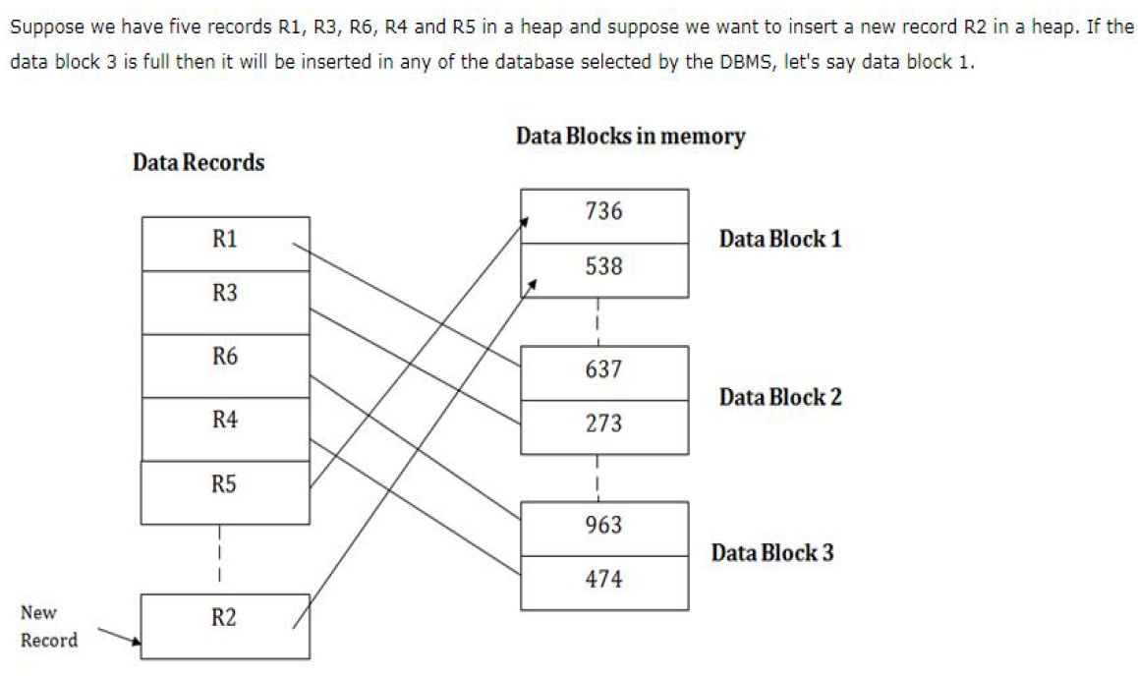
Notes:
If we want to search, update or delete the data in heap file organization,
then we need to traverse the data from staring of the file till we get the
requested record.
If the database is very large then searching, updating or deleting of
record will be time-consuming because there is no sorting or ordering of
records. In the heap file organization, we need to check all the data until
we get the requested record.

Slide 12
Pros and Cons of Heap File Organization – Pros –
Fetching and retrieving records is faster than sequential record but only in case of small databases.
When there is a huge number of data needs to be loaded into the database at a time, then this method of file Organization is best suited.
Cons –
Problem of unused memory blocks.
Inefficient for larger databases.

Slide 13
Hash File Organization
Hash File Organization uses the computation of hash function on some
fields of the records. The hash function's output determines the location
of disk block where the records are to be placed

Slide 14
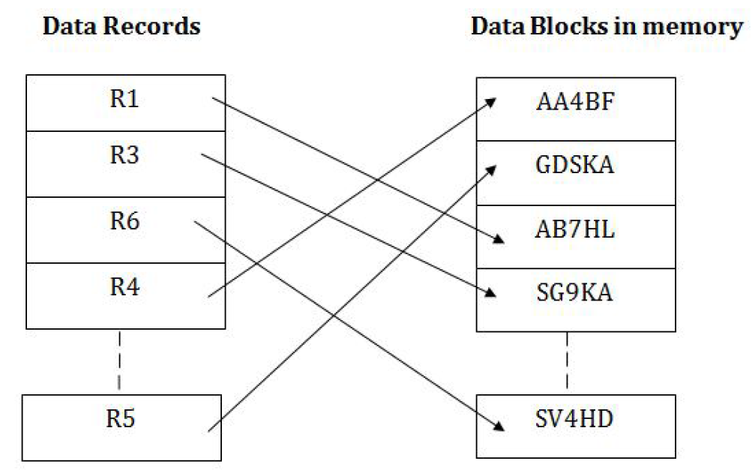
Notes:
When a record has to be received using the hash key columns, then the
address is generated, and the whole record is retrieved using that
address. In the same way, when a new record has to be inserted, then the
address is generated using the hash key and record is directly inserted.
The same process is applied in the case of delete and update.
In this method, there is no effort for searching and sorting the entire file.
In this method, each record will be stored randomly in the memory.

Slide 15
Notes:
In database management system, When we want to retrieve a particular data, It becomes very inefficient to search all the index values and reach the desired data. In this situation, Hashing technique comes into picture. Hashing is an efficient technique to directly search the location of desired data on the disk without using index structure. Data is stored at the data blocks whose address is generated by using hash function. The memory location where these records are stored is called as data block or data bucket

Slide 16
Hash File Organization
Data bucket – Data buckets are the memory locations where the records are stored. These buckets are also considered as Unit Of Storage.
Hash Function – Hash function is a mapping function that maps all the set of search keys to actual record address. Generally, hash function uses primary key to generate the hash index – address of the data block. Hash function can be simple mathematical function to any complex mathematical function.
Hash Index-The prefix of an entire hash value is taken as a hash index. Every hash index has a depth value to signify how many bits are used for computing a hash function. These bits can address 2n buckets. When all these bits are consumed ? then the depth value is increased linearly and twice the buckets are allocated.

Slide 17
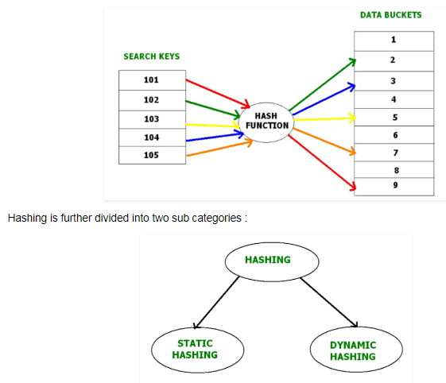
Below given diagram clearly depicts how hash function work:

Slide 18
Static Hashing
In static hashing, when a search-key value is provided, the hash function always computes the same address. For example, if we want to generate address for STUDENT_ID = 10 using mod (3) hash function, it always result in the same bucket address 1. There will not be any changes to the bucket address here. Hence number of data buckets in the memory for this static hashing remains constant throughout.

Slide 19
Operations –
▪ Insertion – When a new record is inserted into the table, The hash function h generate a bucket address for the new record based on its hash key K.
Bucket address = h(K)
▪ Searching – When a record needs to be searched, The same hash function is used to retrieve the bucket address for the record. For Example, if we want to retrieve whole record for ID 76, and if the hash function is mod (5) on that ID, the bucket address generated would be 1. Then we will directly got to address 1 and retrieve the whole record for ID 76. Here ID acts as a hash key.
▪ Deletion – If we want to delete a record, Using the hash function we will first fetch the record which is supposed to be deleted. Then we will remove the records for that address in memory.
▪ Updation – The data record that needs to be updated is first searched using hash function, and then the data record is updated.

Slide 20
Now, If we want to insert some new records into the file But the data bucket address generated by the hash function is not empty or the data already exists in that address. This becomes a critical situation to handle. This situation in the static hashing is called bucket overflow.
How will we insert data in this case?

Slide 21
There are several methods provided to overcome this situation.
1. Open Hashing –
In Open hashing method, next available data block is used to enter the new record, instead of overwriting older one. This method is also called linear probing.
For example, D3 is a new record which needs to be inserted , the hash function generates address as 105. But it is already full. So the system searches next available data bucket, 123 and assigns D3 to it.

Slide 22
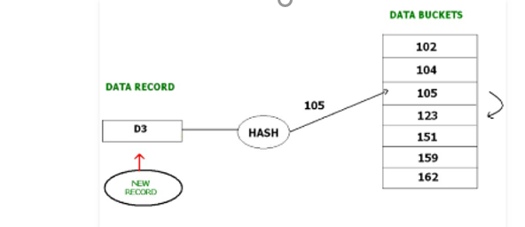

Slide 23
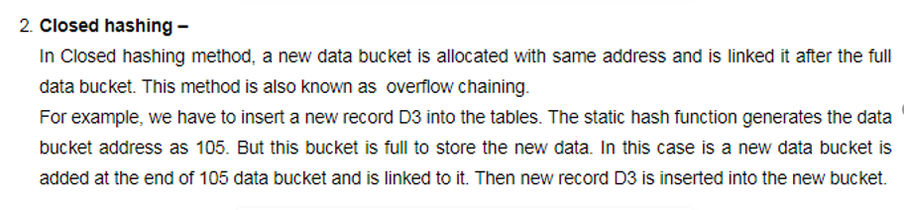

Slide 24
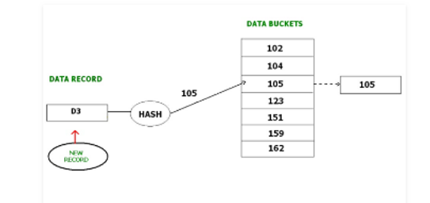

Slide 25
Dynamic Hashing
The drawback of static hashing is that that it does not expand or shrink dynamically as the size of the database grows or shrinks. In Dynamic hashing, data buckets grows or shrinks (added or removed dynamically) as the records increases or decreases. Dynamic hashing is also known as extended hashing.
In dynamic hashing, the hash function is made to produce a large number of values. For Example, there are three data records D1, D2 and D3 . The hash function generates three addresses 1001, 0101 and 1010 respectively. This method of storing considers only part of this address – especially only first one bit to store the data. So it tries to load three of them at address 0 and 1.
Notes:
ghjmk

Slide 26
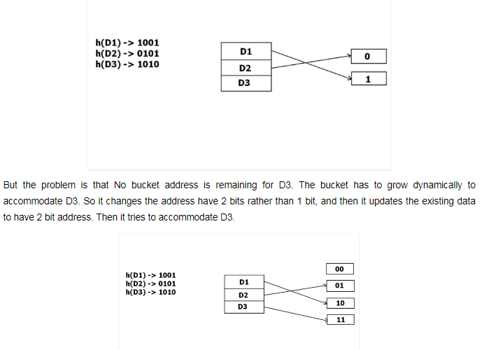

Slide 27
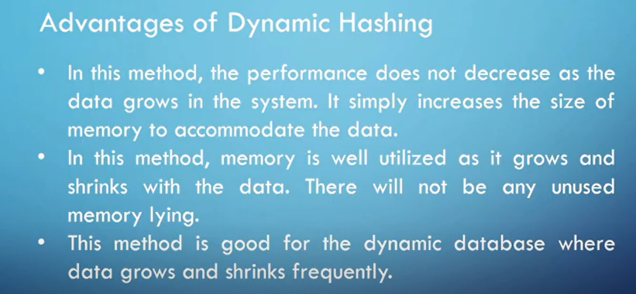

Slide 28
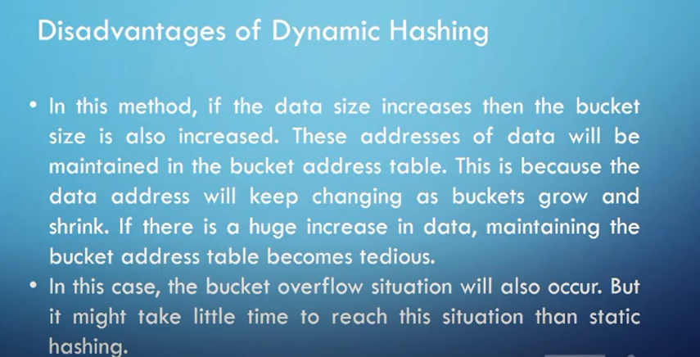

Slide 29
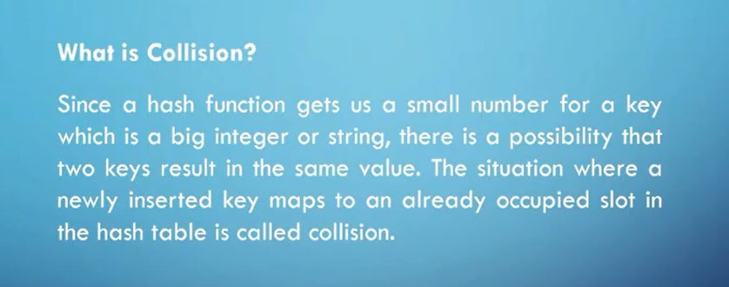

Slide 30
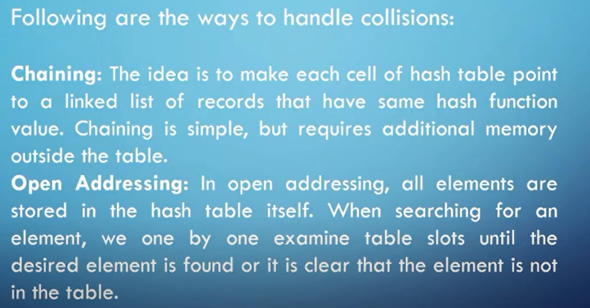

Slide 31
The term ______ is used to denote a unit of storage that can store one or more records a) Basket b) Bucket c) Unit d) Set
Notes:
b

Slide 32
If K denotes the set of all the search key values, and B denotes the set of all bucket addresses, a function from K to B is called as __________ a) Bucket function b) Address function c) Hash function d) Search function
Notes:
C
If K denotes the set of all the search key values, and B denotes the set of all bucket addresses, a function h from K to B is called as the hash function. It determines which bucket should contain the data in question.

Slide 33
In a __________ , we obtain the address of the disk block containing a desired record directly by computing a function on the search key value of the record a) Hash file organization b) Hash index organization c) Hashing address d) None of the mentioned
Notes:
a

Slide 34
What is a bucket overflow? a) When a bucket does not have enough space b) There are insufficient buckets c) When Bucket skew occurs d) All of the mentioned
Notes:
D
Some buckets are assigned more records than are others, so a bucket may overﬂow even when other buckets still have space. This situation is called bucket skew.

Slide 35
Dynamic hashing allows us to? a) Accommodate the growth of the database b) Accommodate the shrinkage of the database c) Allows modification of hash function d) All of the mentioned
Notes:
d

Slide 36
Dynamic hashing is also called as _________ a) Extended hashing b) Extendable hashing c) Static hashing d) Movable hashing
Notes:
b

Slide 37
Which of the following operations can be performed on an extendable hash structure? a) Lookup b) Insertion c) Deletion d) All of the mentioned
Notes:
d

Slide 38
The space overhead in dynamic hashing is ________ than that of static hashing a) More b) Less c) Equal d) None of the mentioned
Notes:
b

